Slide 1
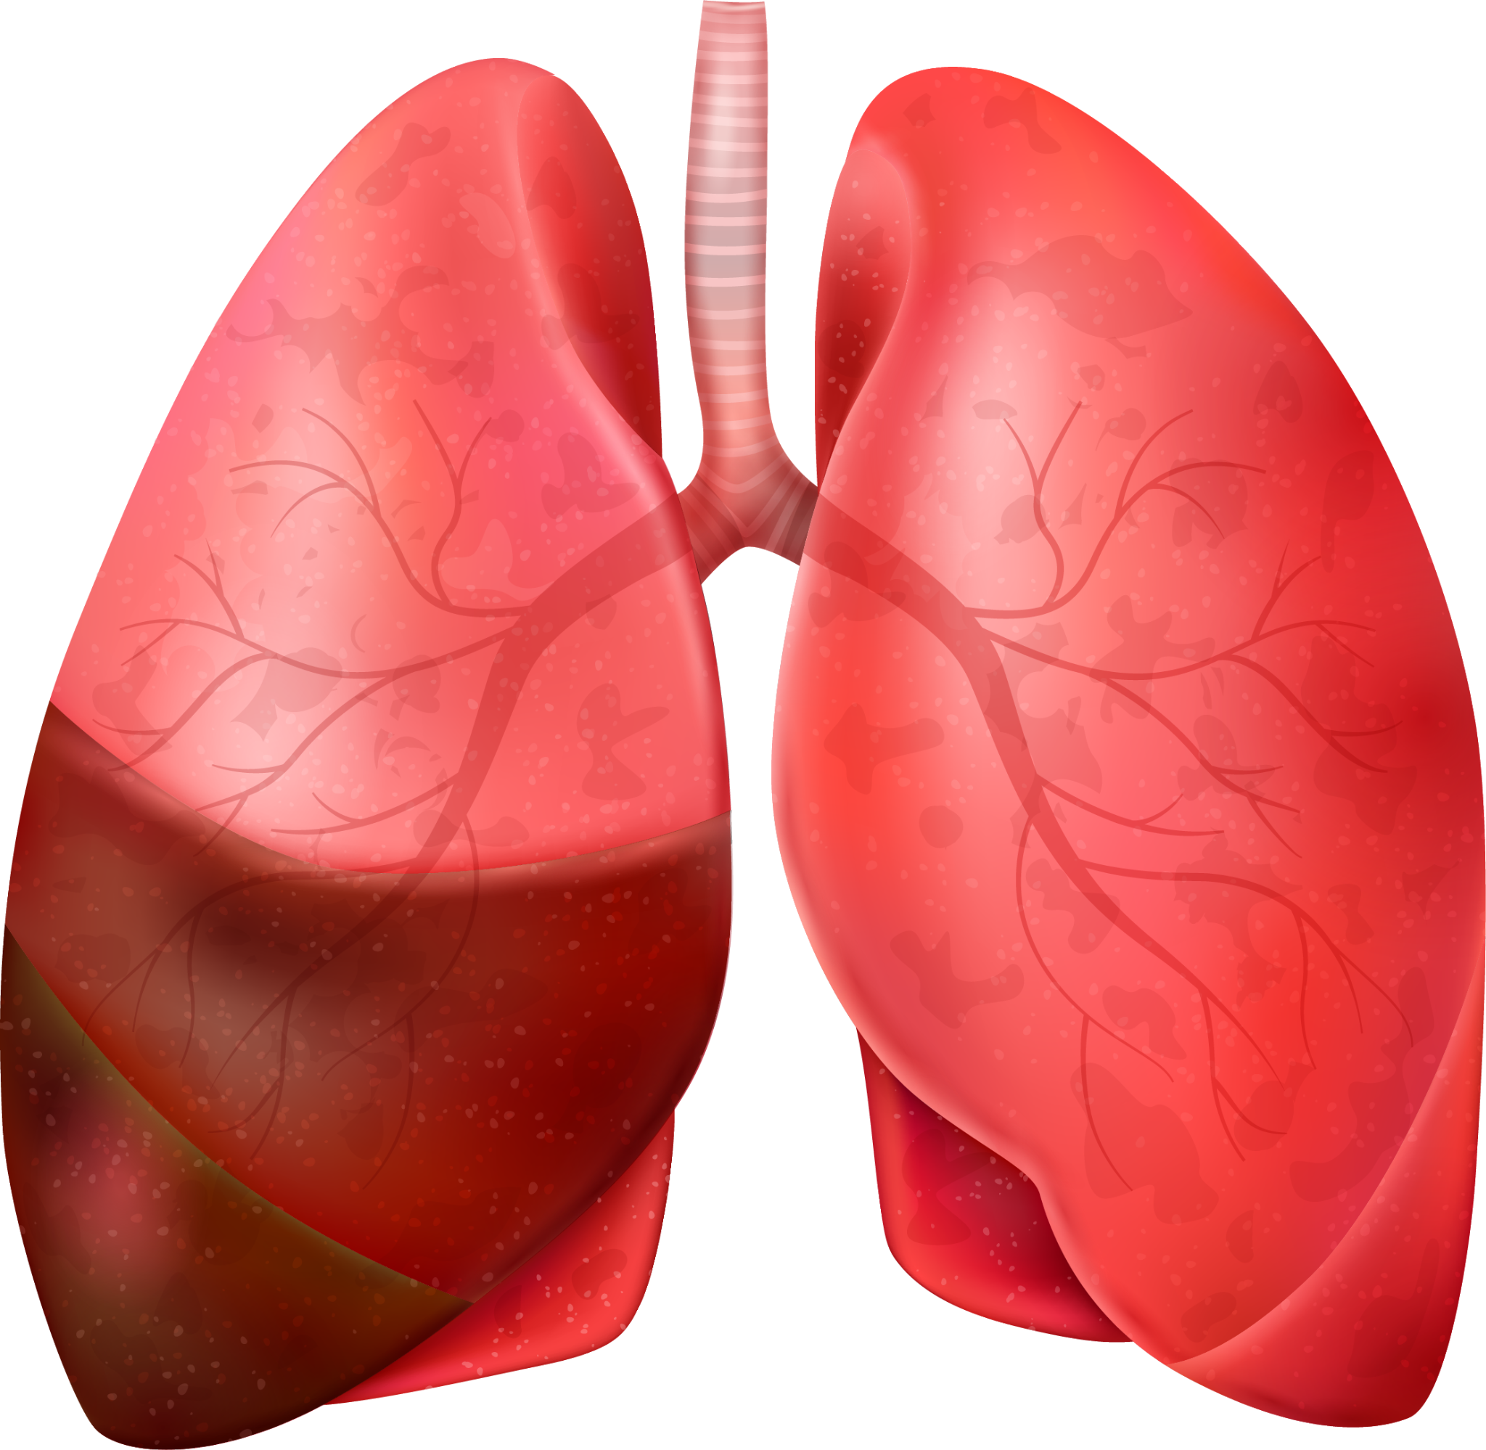
IMAGE CLASSIFICATION OF X-RAY IMAGES FOR PNEUMONIA DETECTION

Slide 2
PHASE 4 GROUP 5 MEMBERS
Lisa Mwikali
Nicole Bosibori
Ivan Wawire
Anne Njoroge
Maureen Muriithi
Charles Egambi

Slide 3
INTRODUCTION
Pneumonia is a common and potentially fatal lung infection. Accurate diagnosis is essential for effective treatment and patient management. The "Large Dataset of Labeled Optical Coherence Tomography (OCT) and Chest X-Ray Images" is a comprehensive collection of medical images, aiming to support advancements in medical diagnosis through deep learning.

Slide 4
Business problem
In healthcare, accurate and efficient disease diagnosis is vital. Traditional methods of diagnosing pneumonia involve lengthy exams and lab tests, often requiring multiple doctor visits. This project aims to streamline this process using a deep learning model to detect pneumonia from chest x-ray images, providing faster and more precise diagnoses.

Slide 5
PROJECT GOALS
Main Objective
To develop a deep learning model to classify chest x-ray images for pneumonia detection.
Specific Objectives
Investigate and apply various deep learning models to determine the most effective architecture for pneumonia detection.
Use the prepared dataset to train the deep learning model.
Assess the trained model’s performance using metrics such as accuracy, sensitivity, specificity, and area under the receiver operating characteristic (ROC) curve to validate its effectiveness in detecting pneumonia.

Slide 6
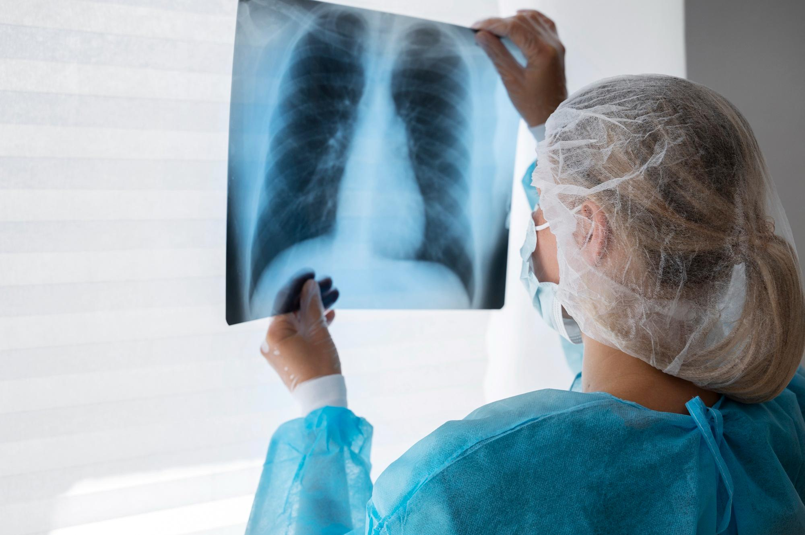
STAKEHOLDERS
Health Professionals
Patients
Radiologists
Medical Researchers

Slide 7
DATA OVERVIEW
Source: Mendley Data
Data Organization: The images are categorized into “train”, “test” and “val” folders
Categories: The images can be classified into two ; “Pneumonia” and “Normal”
Patient Demographics: Ages 1-5years, Guangzhou Women and Children’s Medical Center
Image Details: Anterior – posterior chest X-rays, part of routine care

Slide 8

METHODOLOGY
Steps:
Data Preparation and Cleaning:
Importing necessary libraries
Uploading and organizing data
Rescaling the images and verifying directory structure
Exploratory Data Analysis:
Displaying sample images
Analyzing image size, intensity, aspect ration and brightness distributions
Checking class distribution
Model Training: Using various classification models to predict vaccination status.///////
Evaluation: Comparing model performance using metrics like accuracy, loss and precision.

Slide 9
SAMPLE DATA VISUALIZATIONS FROM EXPLORATORY DATA ANALYSIS
Sample images from each class: provides a visual understanding of the types of images in the dataset, distinguishing between normal and pneumonia cases.
Image Size Distribution: shows the variation in dimensions of the x-ray images, which was important for preprocessing steps
Image Intensity Distribution Plot: gives insight into the brightness and contrast of the images, which affects image quality and feature extraction in the deep learning models
Image Aspect Ratio Distribution Histogram: for understanding the shape and proportion of the images, which influences how images are resized and fed into neural networks.
Image Brightness Distribution Plot: highlights the range and mean brightness levels, which can impact image normalization and model performance.
Training Data Class Distribution Bar Chart: show the number of images in the dataset for normal vs pneumonia, which is crucial for understanding if there is class imbalance that might affect model training and evaluation.

Slide 10
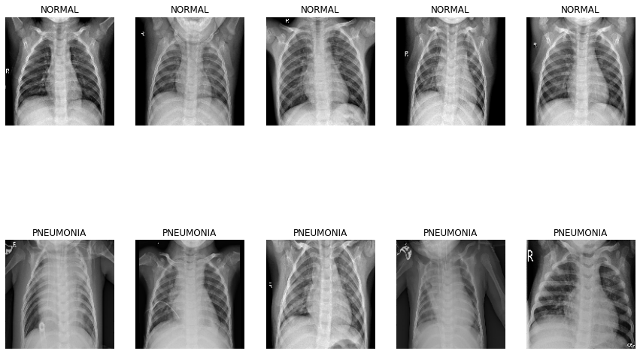
SAMPLE IMAGES TO DISTINGUISH BETWEEN NORMAL & PNEUMONIA CASES

Slide 11
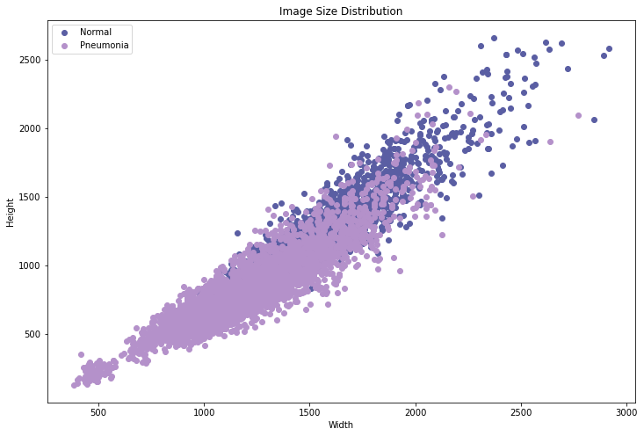
SCATTER PLOT DISPLAYING Image Size Distribution

Slide 12
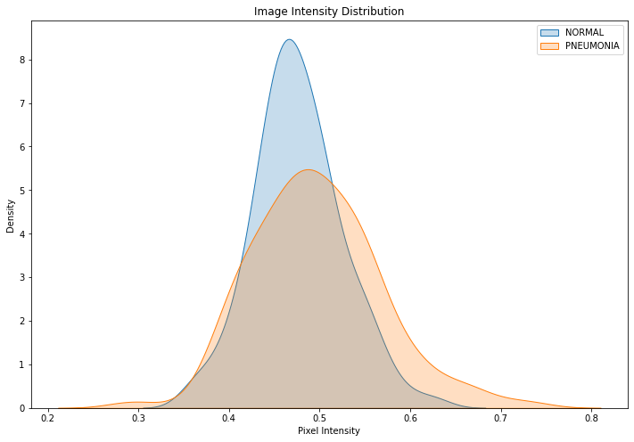
IMAGE INTENSITY DISTRIBUTION

Slide 13
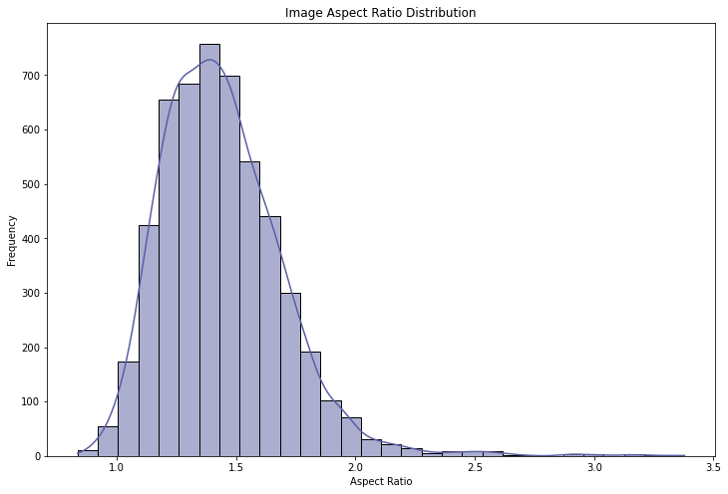
HISTOGRAM SHOWING IMAGE ASPECT RATIO DISTRIBUTION

Slide 14
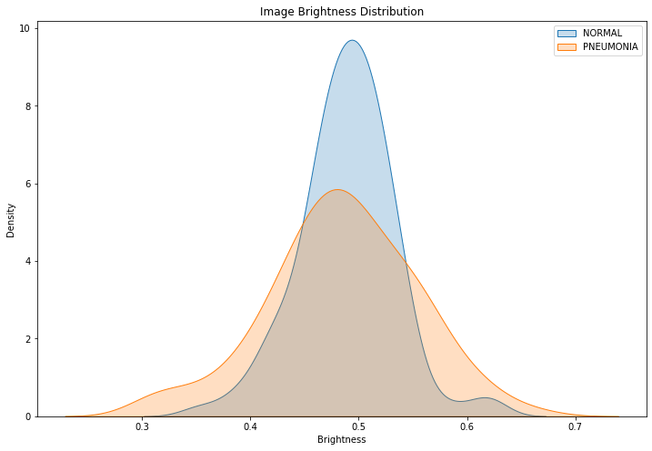
IMAGE BRIGHTNESS DISTRIBUTION

Slide 15
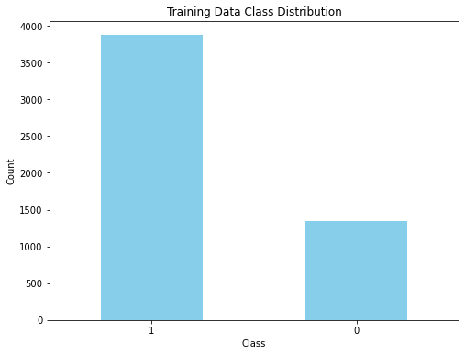
BAR GRAPH DISPLAYING TRAINING DATA CLASS DISTRIBUTION

Slide 16
KEY INSIGHTS FROM DATA EXPLORATION
Image Size: Data points for normal and pneumonia cases are closely clustered.
Pixel Intensity: Significant overlap with slightly broader distribution for pneumonia images.
Aspect Ratio: Most images have an aspect ratio between 1.0 and 1.5.
Brightness: Normal images are generally brighter on average.
Class Distribution: Balanced class distribution in training data.

Slide 17
Model evaluation

Slide 18
CONCLUSION

Slide 19
RECOMMENDATIONS & NEXT STEPS

